Slide 1
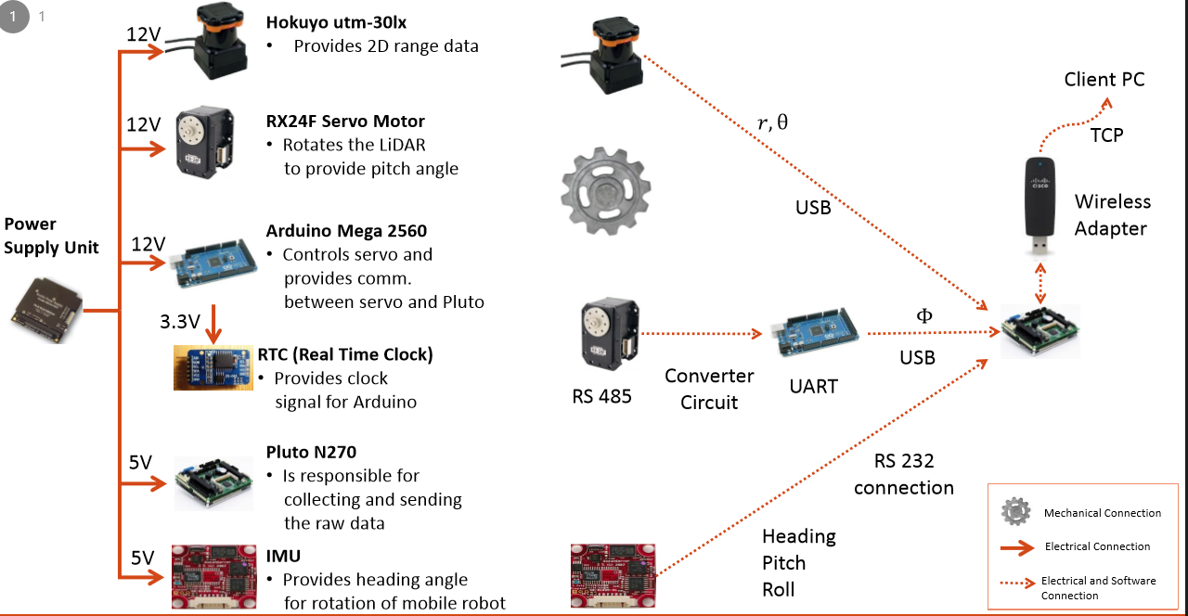
Project Title
(Group Name if available)
Full names of group members in alphabetical order
Supervisor
Affiliation and full name of academic supervisor
Electrical and Electronics Engineering, Hacettepe University
Introduction
Application Areas
Please briefly describe the project using bullet points.
Please describe the motivation of the project by referring to application areas.
You should change the number of sections, section names and sizes, bullet point types based on your needs. Please do not limit yourself to these sections.
Please describe the application areas of the project using visuals such as images, tables and figures.
Specifications and Design Requirements
Results and Discussion
Please explain the overall specifications and design requirements of the project using visuals such as images, pictures, figures and tables.
Describe the results obtained in the projects using visuals such as figures and tables.
Please comment on the results presented in the poster.
Describe how you achieved the project specifications and design requirements.
Discuss the implications of the results obtained in the project.
Comment on possible future work related to your projects.
Solution Methodology
Describe the electronic, mechanical and software architectures of the proposed solution methodology using visuals (see the example below).
Figure: An overall description of the project components.
Describe the theoretical and practical aspects of the solution techniques developed and/or utilized in the project using illustrations and equations if needed.
You may use flow diagrams to describe the process adopted in the solution methodology.
References
Please list the sources related to your project using Harvard style referencing, see the example below.
Mitchell, J.A. ‘How citation changed the research world’, The Mendeley, 62(9), p70-81.
Acknowledgements
This project was completed within the context of ELE401-401 Graduation Project courses in Hacettepe University, Faculty of Engineering, Department of Electrical and Electronics Engineering.
We thank ….. for his/her invaluable contributions to our project.

